Slide 1
Evaluating change in mental status: Long term care
Ruth Kandel, MD
Director, Infection Control, Hebrew SeniorLife
Assistant Professor, Harvard Medical School
Boston, MA
Laurie Herndon, GNP-BC
Director of Clinical Quality
Massachusetts Senior Care Foundation

Slide 2





Change in Mental Status
Long Term Care
Ruth Kandel, MD
Director, Infection Control
Hebrew SeniorLife
Assistant Professor
Harvard Medical School
Boston, MA
Consultant to Massachusetts Partnership Collaborative:
Improving Antibiotic Stewardship for UTI

Slide 3
Asymptomatic Bacteriuria (ASB)
Laboratory diagnosis
Positive urine culture
  Colony count significant (> 10⁵ cfu/mL)
Absence of symptoms
                Clinical Infectious Disease 2010;50:625-663

Slide 4
Prevalence of ASB
  POPULATION Prevalence %
Older long-term care residents
  Women 25-50
  Men 15-40
Patients with an indwelling catheter
  Short-term 9-23
  Long-term 100
                CID2005;40:643-654

Slide 5
Treatment for ASB Indicated
Pregnant women
  Increased risk for adverse outcomes
Urologic interventions
    TURP
    Any urologic procedure with potential mucosal bleeding

Slide 6
Treatment for ASB Not Indicated
Premenopausal, non pregnant women
Diabetic women
Older persons living in the community
Elderly living in long term care facilities
Persons with spinal cord injury
Catheterized patients
                CID2005;40:643-654

Slide 7

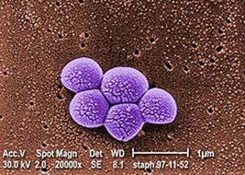
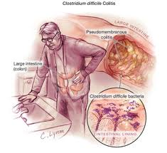
Problems with Antibiotics
Adverse Drug Reactions
MDRO
C Difficile Infection

Slide 8

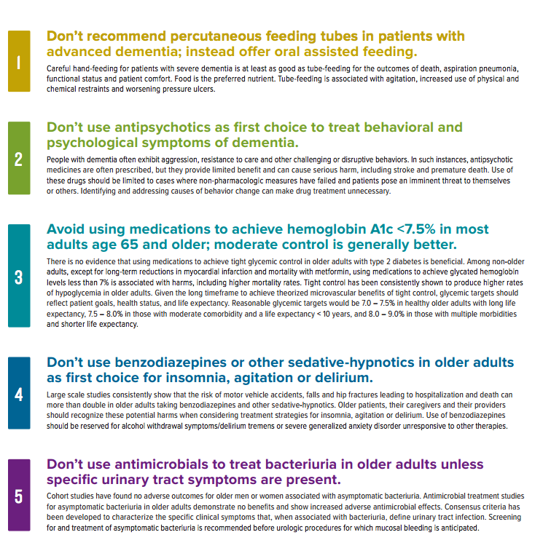

Slide 9
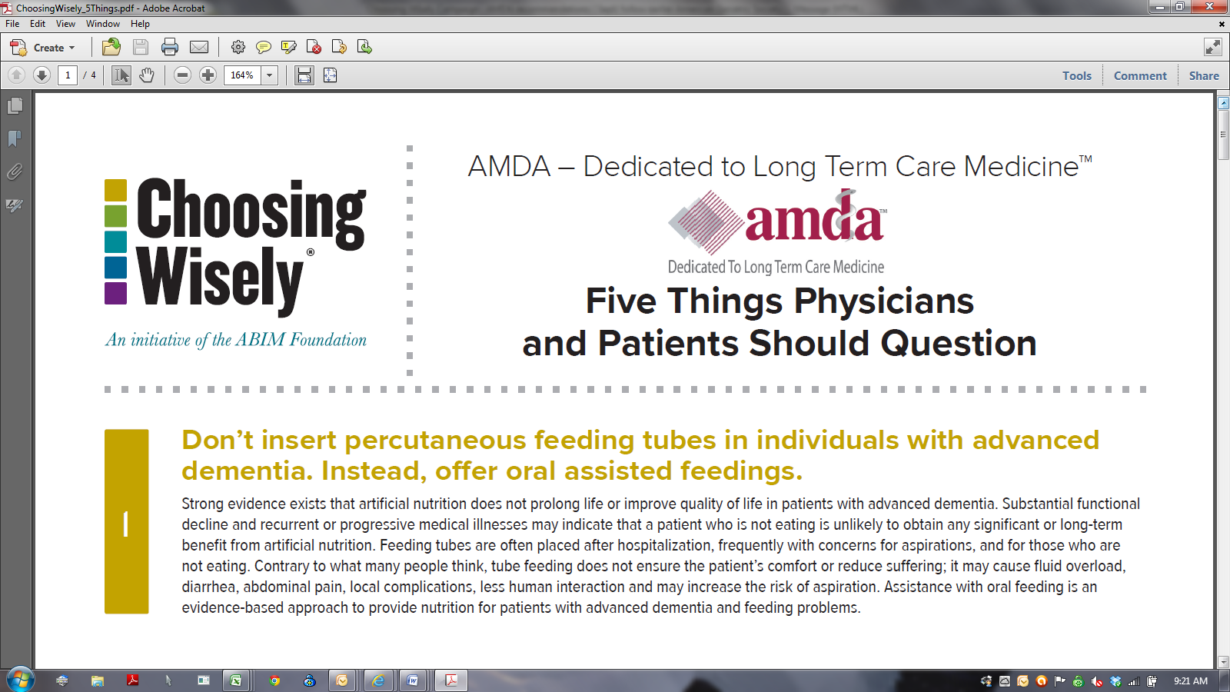
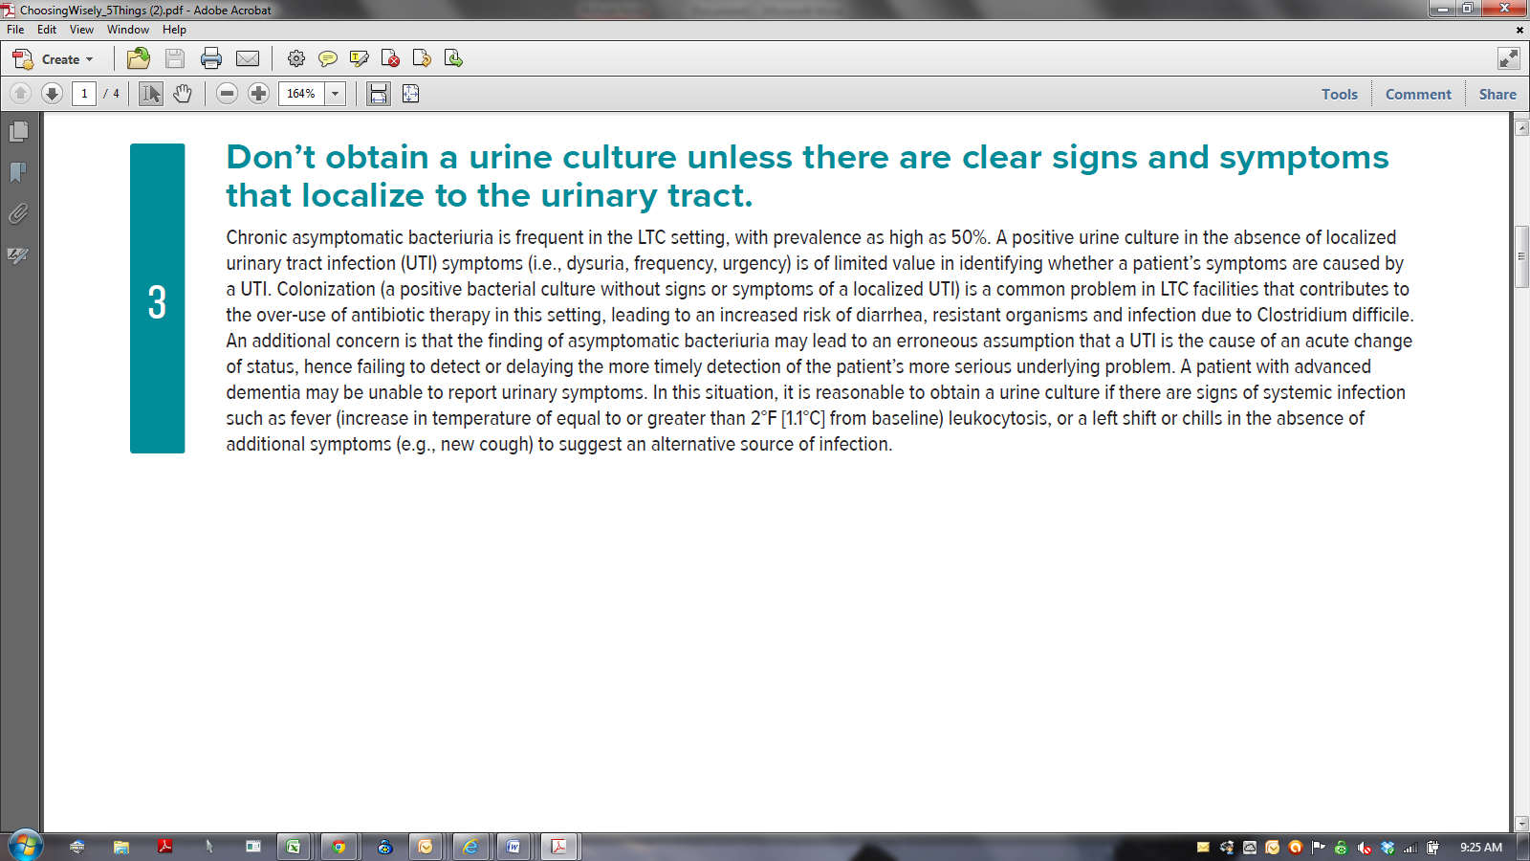

Slide 10
Change in Mental Status ≠ Symptomatic Urinary Tract Infection
LTCF residents with cognitive impairment are more likely to have ASB (no symptoms, positive urine culture).
LTCF residents with cognitive impairment are more vulnerable to changes in mental status with any new problem.
THEREFORE, resident with cognitive impairment and change in mental status
  MORE LIKELY to have a positive urine culture,
  Independent of whether infection is the cause of clinical decline,
  OR if infection is present, whether urinary tract is the source.
        JAGS 2009 57:1113-1114

Slide 11
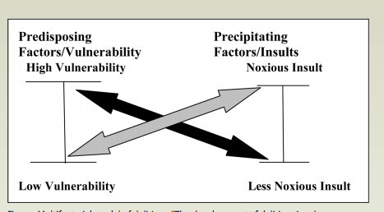
Vulnerability Factors
Delirium
    J of Geront Nurs 2009;35:11-18

Slide 12
Acute Change in Mental Status
Presentation Case #1
A resident in her 80s with dementia (moderate stage) and vague history of psychiatric disorder
  Agitated in bed and would not get up
  Yelling at staff
  Breakfast brought to her but she threw it on the floor
With difficulty a set of vital signs were obtained that was normal except slight increase in pulse (90s).
Resident incontinent at baseline and diaper was wet.
Exam essentially at baseline except for suprapubic pain and tenderness

Slide 13
Acute Change in Mental Status
Diagnosis Case #1
Foley placed (with difficulty) and volume drained TWO LITERS with complete resolution of agitation.
Diaper had been “wet” due to overflow incontinence.

Slide 14
Revised McGeer
Resident Without Indwelling Catheter
(A) Clinical (At least one of the following must be met) | (B) Lab (At least one of the following must be met)
Either of the following: ☐ Acute dysuria or ☐ Acute pain, swelling or tenderness of testes, epididymis or prostate | 1. Voided specimen: Positive urine culture (> 10⁵ cfu/mL) no more than 2 organisms
If either FEVER or LEUKOCYTOSIS present need to include ONE or more of the following: □ Acute costovertebral angle pain or tenderness □ Suprapubic pain □ Gross hematuria □ New or marked increase in incontinence □ New or marked increase in urgency □ New or marked increase frequency | 2. Straight cath specimen: Positive urine culture (> 10² cfu/mL) any number of organisms
3. If neither FEVER or LEUKOCYTOSIS present INCLUDE TWO or more of the ABOVE. | Infect Control Hosp Epidemiol 2012;33:965-977

Slide 15
Revised McGeer
Resident With Indwelling Catheter
(A) CLINICAL (At least one of the following present with no alternate explanation) | (B)LAB (Must be met)
☐ Fever | ☐ Positive urine culture (> 10⁵ cfu/mL) of any organism(s)
☐ Rigors
☐ New onset hypotension
☐ Either acute change in mental status or acute functional decline, with no alternate diagnosis AND leukocytosis
☐ New onset costovertebral angle pain or tenderness
☐ New onset suprapubic pain
☐ Acute pain, swelling or tenderness of the testes, epididymis or prostate
☐ Purulent drainage from around the catheter | Infect Control Hosp Epidemiol 2012;33:965-977

Slide 16
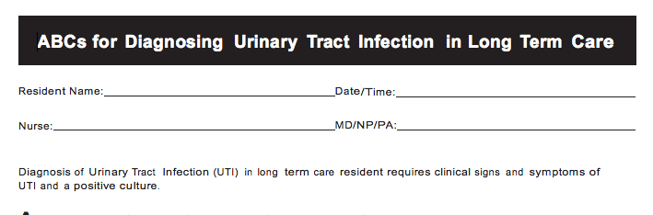
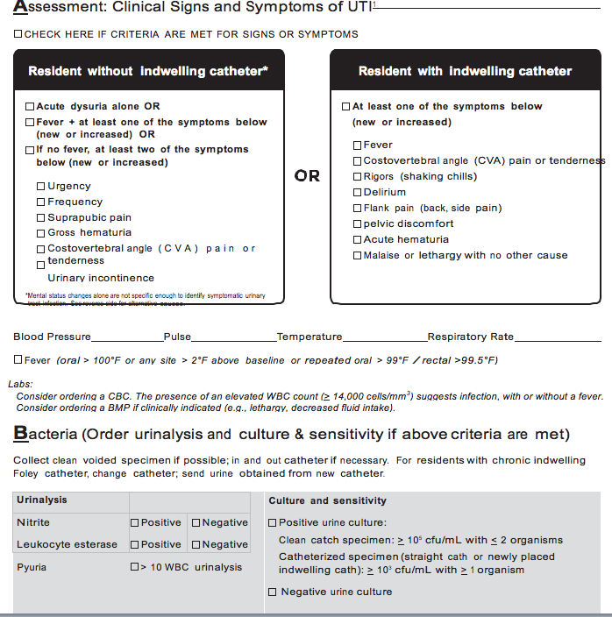

Slide 17
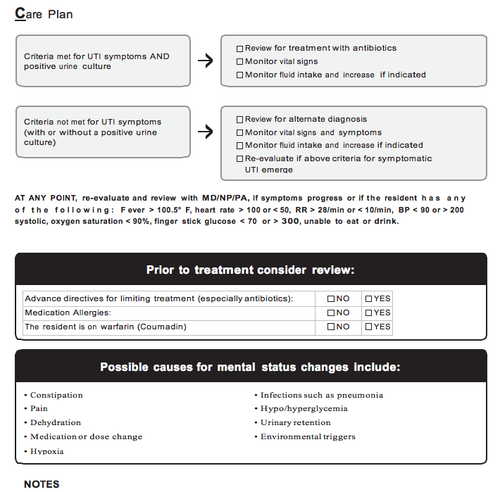

Slide 18
Change in Mental Status in Dementia
Acute change in COGNITION
  Confusion
Acute change in BEHAVIOR
  Aggression or agitation (verbal or physical)
  Resistance to care
  Hallucinations
  Delusions
  Lethargy
Acute change in FUNCTION (activities of daily living)

Slide 19
Confusion Assessment Method Criteria
Acute change in resident’s mental status from baseline
Fluctuating Behavior
  Coming and going or changing in severity during the assessment.
Inattention
  Difficulty focusing attention (e.g., unable to keep track of discussion or easily distracted).
Disorganized thinking
  Thinking is incoherent (e.g., rambling conversation, unclear flow of ideas, unpredictable switches in subject).
Altered level of consciousness
  Level of consciousness is described as different from baseline (e.g., hyperalert, sleepy, drowsy, difficult to arouse, nonresponsive).
    McGeer Revised 2012

Slide 20
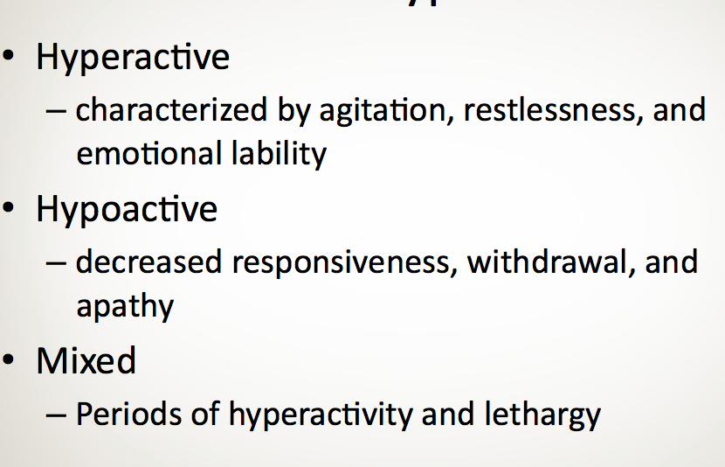
Subtypes

Slide 21
Course of Subsyndromal Delirium
Long Term Care Residents
There may be a continuum between no delirium and full delirium characterized by
  Increasing number of symptoms
  Increasing duration of episodes
  Am J Geri Psych March 2013

Slide 22
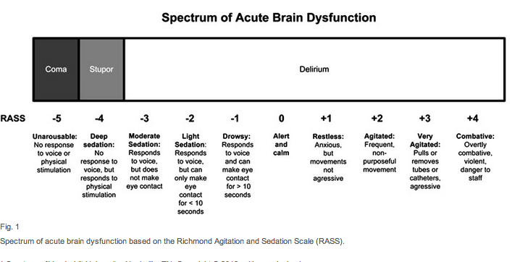
Richmond Agitation and Sedation Scale
Clinics in Geri Med 2013;29:101-136

Slide 23
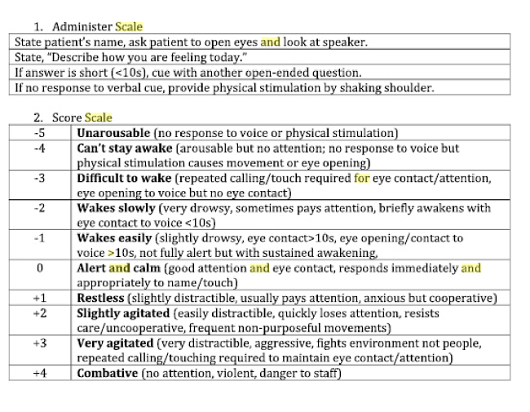
The Modified Richmond Agitation and Sedation Scale (mRASS): Serial Administration

Slide 24

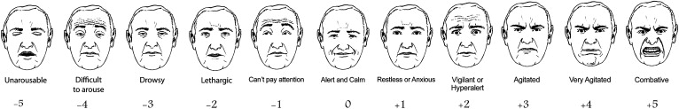
A preliminary example of a “Faces” mental status vital sign.
Joseph H. Flaherty , Kenneth Shay , Charlene Weir , Barbara Kamholz , Kenneth S. Boockvar , Marianne Shaughnessy ,...
Journal of the American Medical Directors Association Volume 10, Issue 6 2009 379 - 380
http://dx.doi.org/10.1016/j.jamda.2009.04.001

Slide 25
Acute Change in Mental Status
Presentation Case # 2
Female resident in her 80s noted to be confused and lethargic
Vital signs normal
Physical exam normal
History significant for dementia (mild), hypertension, diabetes (controlled on oral meds), Parkinson’s disease

Slide 26
Acute Change in Mental Status
Case # 2
Glucoscan obtained as part of evaluation- 35.
Treated with Glucagon IM and “woke up”.
Subsequent history revealed decreased intake for past several days. Work up for underlying problem was negative.

Slide 27
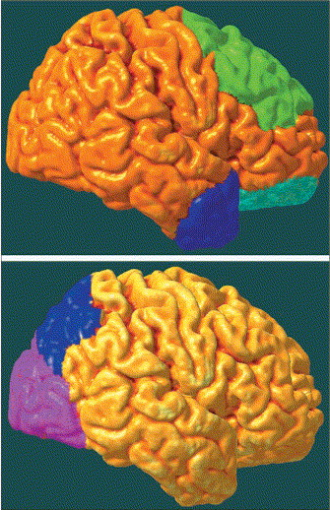
Influence of regional pathologies on behavioral symptoms in dementia
Top: Alzheimer’s disease. Reduced frontal lobe activity contributes to apathy and behavioral disinhibition
Bottom: Dementia with Lewy bodies. Reductions in posterior visual activity contributes to visual hallucinations.
.
The Lancet Neurology Volume 4, Issue 11 2005 735 - 742

Slide 28
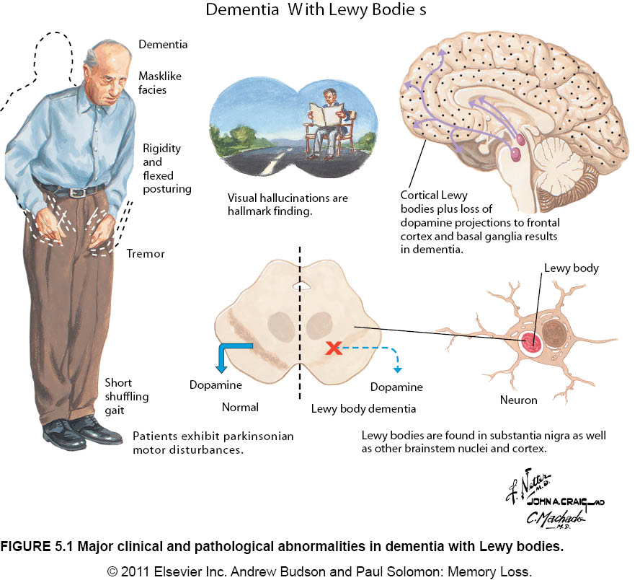

Slide 29
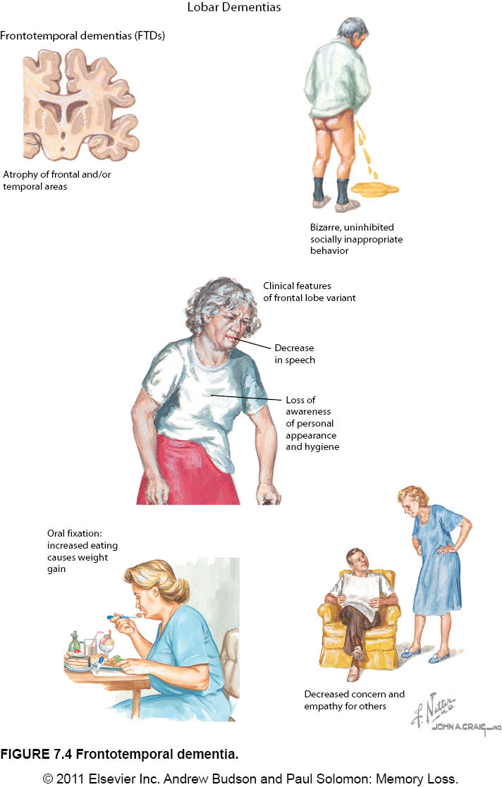
Frontotemporal Dementia

Slide 30
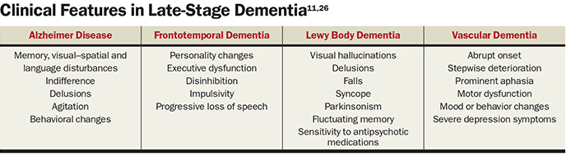
Geriatrics At Your Fingertips American Geriatrics Society

Slide 31
Don’t Forget…
…we all have good and bad days.

Slide 32
Change in Mental Status: Delirium(s)
D Drugs Dementia Discomfort | BEERS Criteria (e.g., anticholinergic, benzodiazepines, hypnotics) OR dose change Dementia Lewy bodies: Fluctuations in alertness and attention Pain, insomnia, depression
E Eyes, ears, environment | Sensory deprivation; vulnerability to environment
L Low oxygen states | Myocardial infarction, stroke, pulmonary embolus
I Infection | Pneumonia, sepsis, symptomatic UTI, cellulitis
R Retention | Urinary retention, constipation
I Ictal states | Seizure disorder
U Underhydration/nutrition | Dehydration
M Metabolic Causes | Low or high blood sugar, sodium abnormalities
S Subdural hematoma | Head trauma Adapted from Saint Louis University Geriatric Evaluation Mnemonics Screening Tools

Slide 33
Change in Mental Status Check List
D | ☐ MEDS (e.g., anticholinergic, benzodiazepines, hypnotics) ☐ Change in medication dose or drug withdrawal ☐ Dementia ☐ Depression ☐ Discomfort (e.g., pain, lack of sleep)
E | ☐ Glasses / hearing aids ☐ Noise level / lighting
L | ☐ Acute cardiac, respiratory or neurologic problems (e.g., MI, CHF, pulmonary embolus, stroke) ☐ Hypoxia (O2 sat)
I | ☐ Infection (e.g., pneumonia, symptomatic UTI, cellulitis)
R | ☐ Urinary retention, constipation or impaction (check PVR, rectal exam)
 | ☐ Seizure disorder
U | ☐ Dehydration (check BMP)
M | ☐ Screen for metabolic abnormalities (e.g., high or low blood sugar, sodium abnormalities) (check BMP)
S | ☐ Head trauma

Slide 34
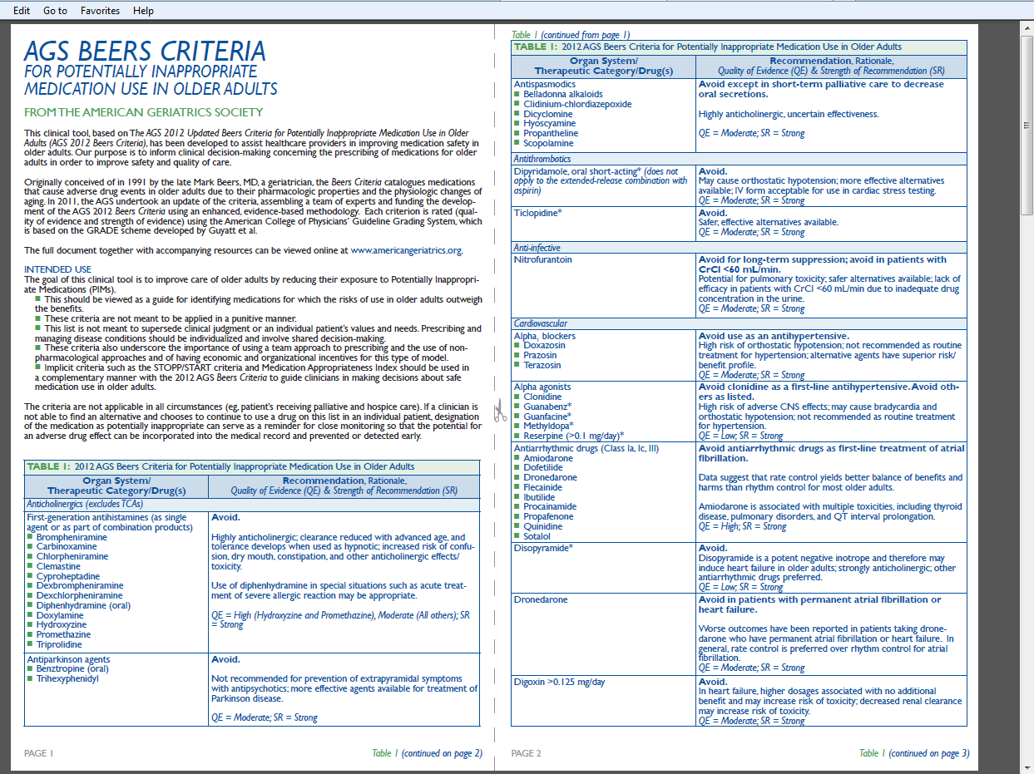
Beers Criteria 2012

Slide 35
Acute Change in Mental Status
Presentation Case # 3
A resident without dementia became acutely confused.
Physical exam including vital signs were normal except for change in mental status.
Diagnosed with herpes zoster 48 hours ago and started on acyclovir.

Slide 36
Acute Change in Mental Status
Case # 3
Herpes zoster (shingles): Acyclovir
Oral: Immunocompetent: 800 mg 5 times daily for 7-10 days (dose resident was getting)
Clcr 10-25: Administer 800 mg every 8 hours (correct dose for this resident)
Clcr <10: Administer 800 mg every 12 hours

Slide 37

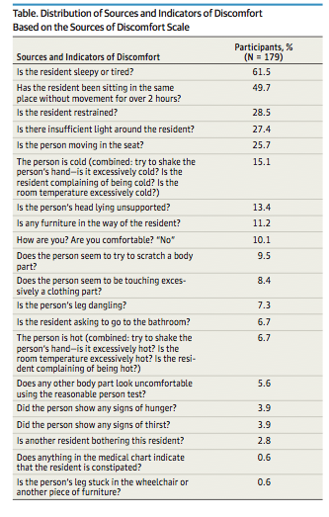
From: Sources of Discomfort in Persons With Dementia JAMA Intern Med. 2013;173(14)1378-1379.
Copyright © 2012 American Medical Association. All rights reserved.

Slide 38
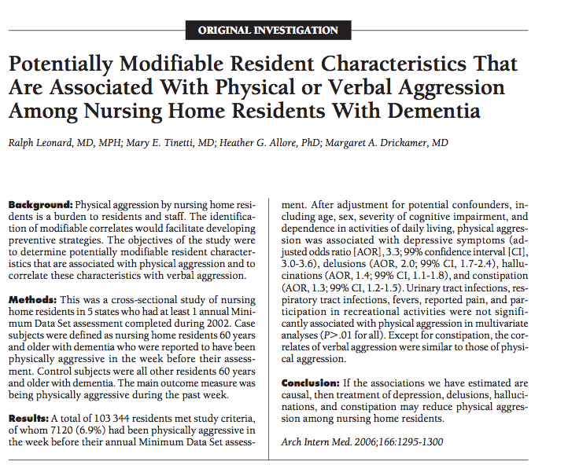

Slide 39
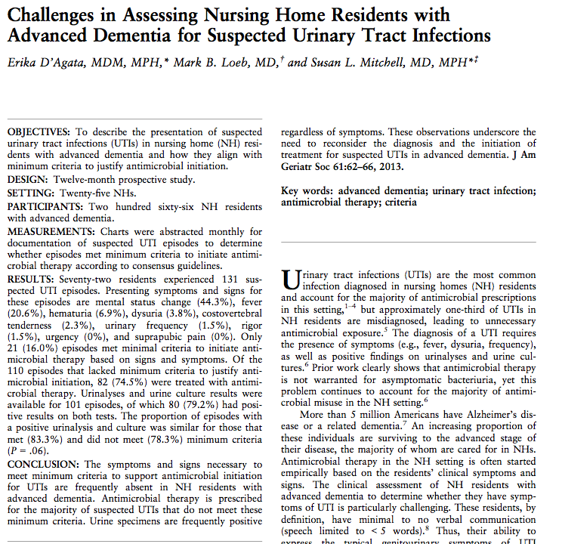

Slide 40
Problem Behaviors
Behavior often has a purpose
Behavior can be triggered
Today is different from yesterday and tomorrow
Improve sleeping pattern
Exclude physical discomfort (pain, hunger)
Maintain a calm demeanor
Identify any pattern to behavior and avoid triggers
Reduce caffeine, sugar
Reduce noise, number of people in room
Distraction with music, walking, reading, etc.
Maintain structure and routine
        Adapted American Geriatric Society

Slide 41
ABCs of Challenging Behavior
Behavior
(B)
Consequences
(C)
Antecedents
(A)

Slide 42
ABCs of Challenging Behavior
Activators (antecedent)
  What are the triggers for the behavior?
Behavior
  What is the nature of the behavior?
Consequences
  What impact does the behavior have on the patient and others?

Slide 43
When Antibiotics are Not Prescribed
(Monitoring Protocol)
Monitor vital signs for several days
Monitor for progression of symptoms or change in clinical status
Encourage fluid intake
Consider alternate diagnosis for nonspecific symptoms (review DELIRIUMS check list)
Check for triggers
If symptoms resolve, no further intervention required
                Modified from Annals of LTC April 2012;20:23-29

Slide 44
Consider Urgent Evaluation
Significantly abnormal vital signs
  Systolic BP <90, heart rate <50 or > 120, respirations >30, temperature <96 or >101
Signs of distress
  New onset respiratory distress with increasing hypoxia or dyspnea
Signs of serious underlying condition
  For example, symptoms of stroke
Escalating aggressive or violent behavior
Resident is a threat to self or others
            AMDA Clinical Practice Guidelines Delirium LTC Setting 2008

Slide 45
Acute Change in Mental Status
Presentation Case # 4
Resident with dementia (mild) transferred to an acute care hospital for new onset confusion and agitation with intermittent lethargy.
Haldol, started in the long term care facility, exacerbated symptoms.
Had recent cellulitis and resident started on antibiotics with no improvement.
Resident with multiple medical problems including past history of seizures.

Slide 46
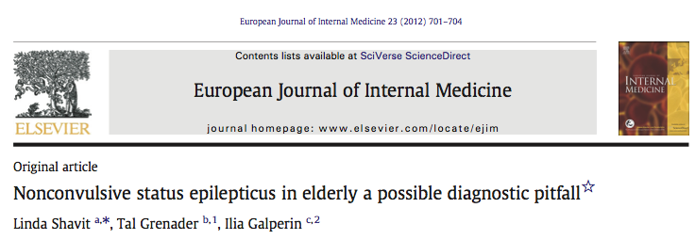
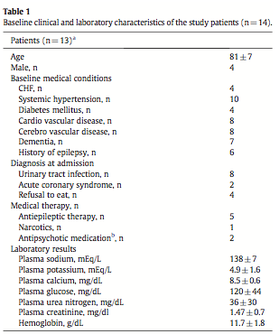

Slide 47
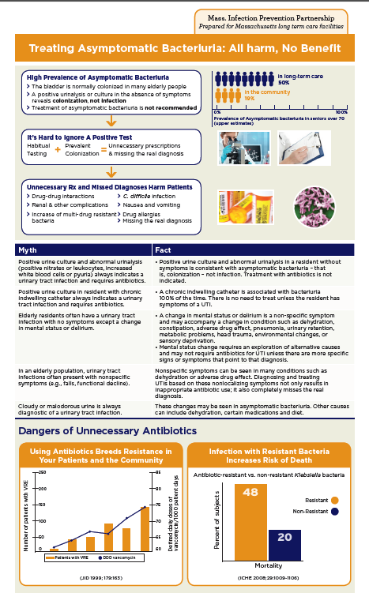
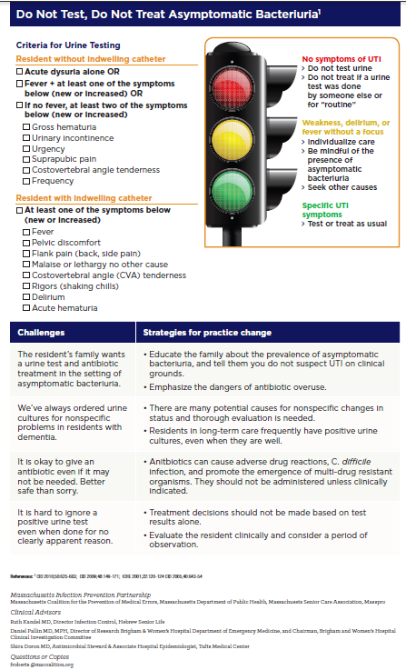
Clinician Education Sheet

Slide 48
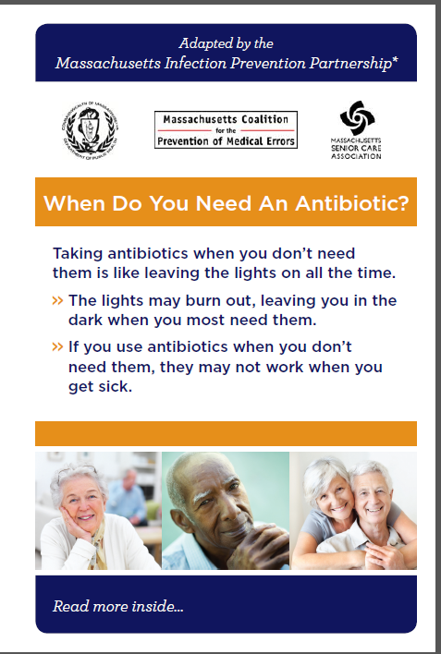
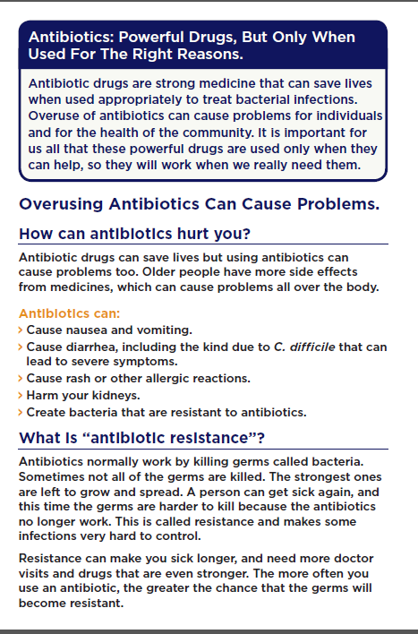
Resident/Family Brochure

Slide 49

Tools that you may already be using that compliment these tools…

Slide 50
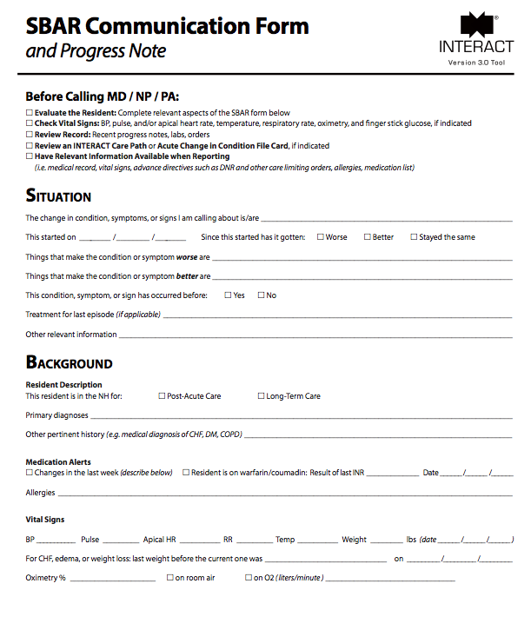
Connecting UTI evaluation to the bigger picture

Slide 51
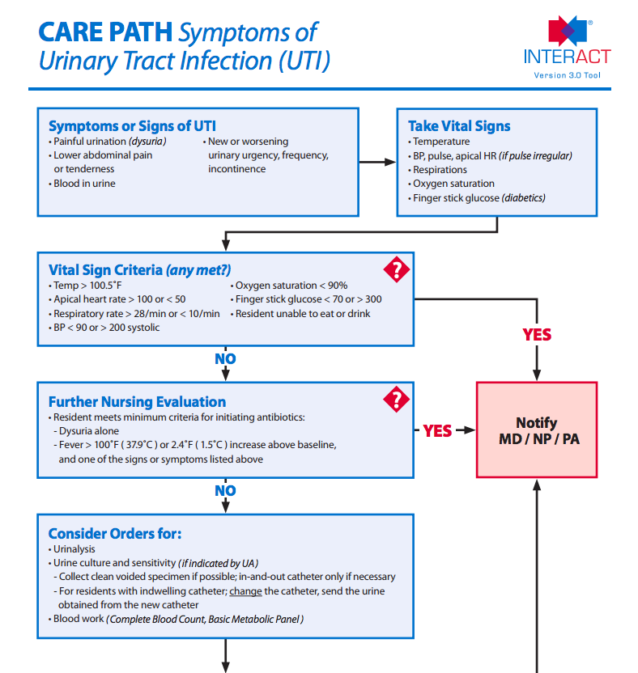
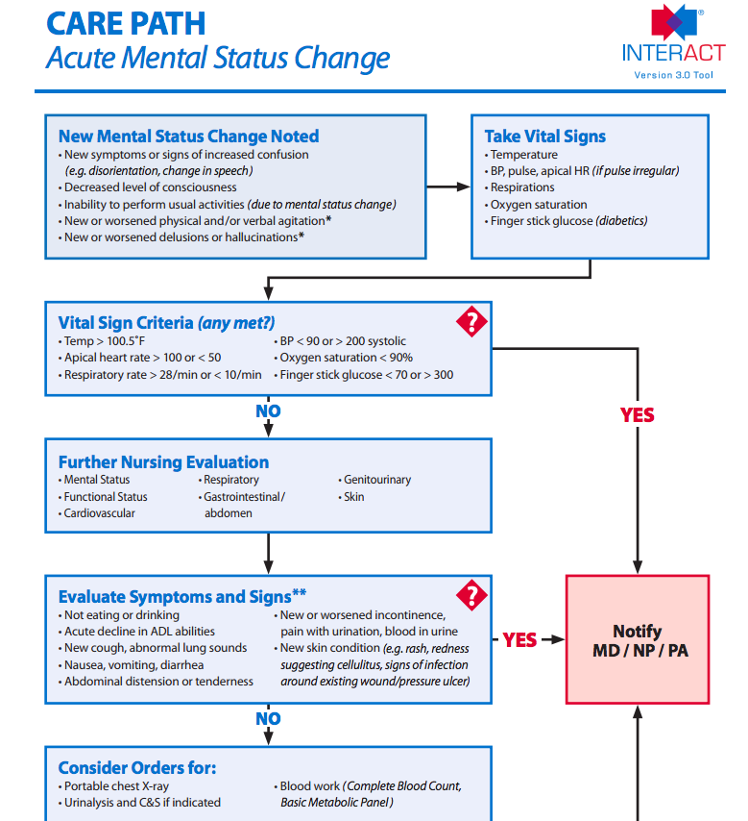
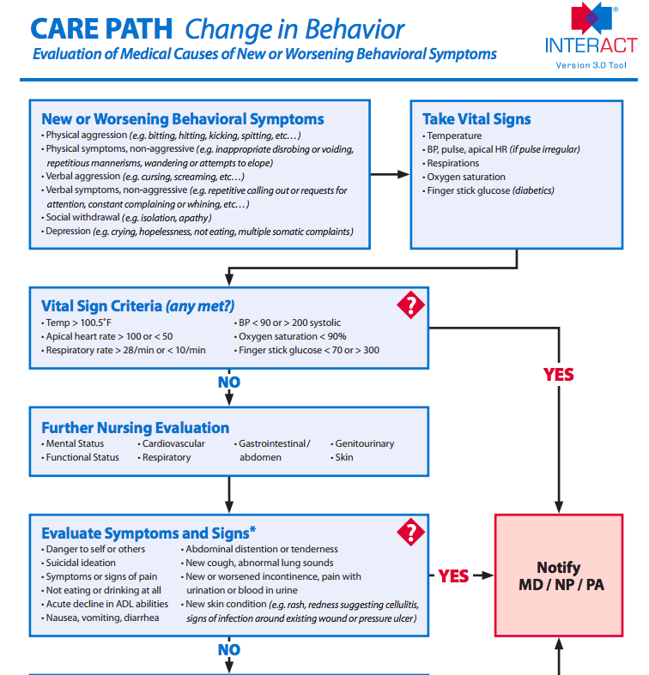

Slide 52

Bottom Line

Slide 53
Up Next
Ongoing measurement and check-in calls
Regional Workshops
  Sturbridge MA: February 26th 8am-noon
  Dedham MA: February 27th 8am – noon
Antibiotic Stewardship in Tong Term Care
    Friday March 14, noon-1pm

Slide 54
Continuing Education Credits
Links for Nursing CEU credits
  https://www.surveymonkey.com/s/January8webinar
Physician, Nursing Home Administrator, or Pharmacist CME credit
  please email ebiocchi@macoalition.org for your survey

